Slide 1
7 Deployments in 7 × 5 minutes https://github.com/mkromberg/deliverapl
Morten Kromberg CTO, Dyalog Ltd.

Slide 2
7 Deployments in 7x5 minutes
Full Stack in APL
Interactive APL Session - Windows
Shebang Script - Linux
Windows GUI "Stand Alone Executable"
Cross-Platform GUI (Desktop AND Web)
Integrated APL Components & Services
Integrated with Python (using PynAPL under Windows)
.NET Assembly (called from C# under Linux)
Web Service in Docker Container (Powershell under Windows & curl under Linux)

Slide 3
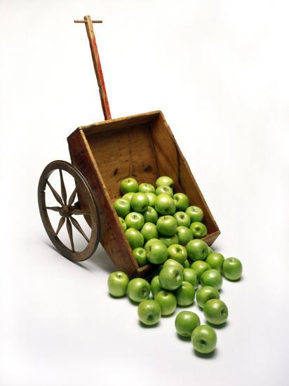
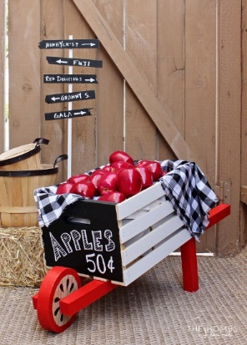
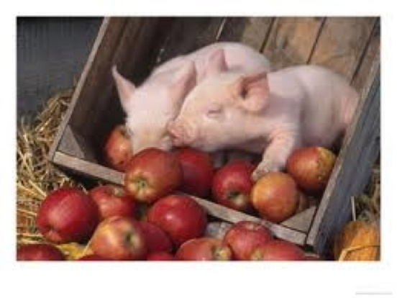

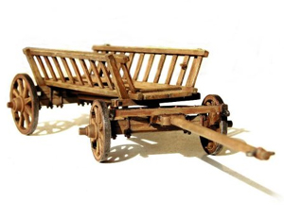
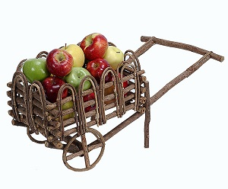

Delivering APLs

Slide 4
Our "Business Logic": (In)Volutions
iv 5
1 2 3 4 5 16 17 18 19 6 15 24 25 20 7 14 23 22 21 8 13 12 11 10 9

Slide 5
The desired result for n=5
→ → → → → ↑ → → → ↓ ↑ ↑ → ↓ ↓ ↑ ← ← ↓ ↓ ← ← ← ← ↓
1 2 3 4 5 16 17 18 19 6 15 24 25 20 7 14 23 22 21 8 13 12 11 10 9

Slide 6
Pattern of movement
→ → → → → ↑ → → → ↓ ↑ ↑ → ↓ ↓ ↑ ← ← ↓ ↓ ← ← ← ← ↓

Slide 7
The "naïve" solution (Python)
from itertools import cycle def involute(n):
fill = [[None for _ in range(n)] for _ in range(n)] directions = cycle([(0, 1), (1, 0), (0, -1), (-1, 0)]) dr, dc = next(directions) r, c = 0, 0
for v in range(n * n): fill[r][c] = v + 1 r_, c_ = r + dr, c + dc if r_ >= n or r_ < 0 or c_ >= n or c_ < 0 or fill[r_][c_]: dr, dc = next(directions) r, c = r + dr, c + dc
return fill

Slide 8
Array Oriented Solution
No
Stinkin'
Loops!

Slide 9
Key Simplification: Think of Matrix as a Long List
1 2 3 4 5 6 7 8 9 10 11 12 13 14 15 16 17 18 19 20 21 22 23 24 25
Movement: → Add 1 to index
↓ Add 5 to index ← Subtract 5 from index ↑ Subtract 1 from index
(repeat until done)

Slide 10
Array of Moves
→ Add 1 to index
↓ Add 5 to index ← Subtract 5 from index ↑ Subtract 1 from index
(repeat until done)
→ → → → → ↑ → → → ↓ ↑ ↑ → ↓ ↓ ↑ ← ← ↓ ↓ ← ← ← ← ↓
One less than 2×n
Reshape (cycling)
Pos followed by Negative
1 followed by n
(¯1+2×5)⍴(+,-) 1 5
1
5
¯1
¯5
1
5
¯1
¯5
1

Slide 11
How many repetitions?
Count backwards from n Repeat each number twice Except the first one
→ → → → → ↑ → → → ↓ ↑ ↑ → ↓ ↓ ↑ ← ← ↓ ↓ ← ← ← ← ↓
Drop the first element from
the two replicate of
the reverse of
the first five integers
1↓2/⌽⍳5
5
4
4
3
3
2
2
1
1

Slide 12
Bring it together
→ → → → → ↑ → → → ↓ ↑ ↑ → ↓ ↓ ↑ ← ← ↓ ↓ ← ← ← ← ↓
Number of repetitions
Replicate
Cycled Directions
(1↓2/⌽⍳5)/(¯1+2×5)⍴(+,-) 1 5
1 1 1 1 1 5 5 5 5 ¯1 ¯1 ¯1 ¯1 ¯5 ¯5 ¯5 1 1 1 5 5 ¯1 ¯1 ¯5 1

Slide 13
Path is cumulative sum (+\) of moves
→ → → → → ↑ → → → ↓ ↑ ↑ → ↓ ↓ ↑ ← ← ↓ ↓ ← ← ← ← ↓
Number of repetitions
Replicate
Cycled Directions
+\
(1↓2/⌽⍳5)/(¯1+2×5)⍴(+,-) 1 5
1 2 3 4 5 10 15 20 25 24 23 22 21 16 11 6 7 8 9 14 19 18 17 12 13
1 1 1 1 1 5 5 5 5 ¯1 ¯1 ¯1 ¯1 ¯5 ¯5 ¯5 1 1 1 5 5 ¯1 ¯1 ¯5 1

Slide 14
Finally: at which step was each cell visited?
iv 5 indices
1 2 3 4 5 1 2 3 4 5 16 17 18 19 6 6 7 8 9 10 15 24 25 20 7 11 12 13 14 15 14 23 22 21 8 16 17 18 19 20 13 12 11 10 9 21 22 22 23 24
path ⍝ Cells visited
1 2 3 4 5 10 15 20 25 24 23 22 21 16 11 6 7 8 9 14 19 18 17 12 13
path ⍳ ⍳25 ⍝ Find each cell in the path
1 2 3 4 5 16 17 18 19 6 15 24 25 20 7 14 23 22 21 8 13 12 11 10 9
⍋path
5 5⍴⍋path ⍝ Reshape into matrix: Tada!
1 2 3 4 5 16 17 18 19 6 15 24 25 20 7 14 23 22 21 8 13 12 11 10 9
1 2 3 4 5 16 17 18 19 6 15 24 25 20 7 14 23 22 21 8 13 12 11 10 9

Slide 15
We're done…
iv 5
1 2 3 4 5 16 17 18 19 6 15 24 25 20 7 14 23 22 21 8 13 12 11 10 9
iv
{⍵ ⍵⍴⍋+\(1↓2/⌽⍳⍵)/(¯1+2×⍵)⍴(+,-)1 ⍵}
→ → → → → ↑ → → → ↓ ↑ ↑ → ↓ ↓ ↑ ← ← ↓ ↓ ← ← ← ← ↓
5 5
Grade Running Total
5 4 4 3 3 2 2 1 1
9
1 5 ¯1 ¯5

Slide 16
Naming the parts
involute←{
directions←(+,-) 1 ⍵
moves←(¯1+2×⍵)⍴directions
repeat←1↓2/⌽⍳⍵
allmoves←repeat/moves
path←+\allmoves
⍵ ⍵⍴⍋path
}
1 5 ¯1 ¯5
1 5 ¯1 ¯5 1 5 ¯1 ¯5 1
5 4 4 3 3 2 2 1 1
1 1 1 1 1 5 5 5 5 ¯1 ¯1 ¯1 ¯1 ¯5 ...
1 2 3 4 5 10 15 20 25 24 23 22 21 14 ...
1 2 3 4 5 16 17 18 19 6 … etc …
iv←{⍵ ⍵⍴⍋+\(1↓2/⌽⍳⍵)/(¯1+2×⍵)⍴(+,-)1 ⍵}

Slide 17
Obfuscation through naming (?!)
involute←{
directions←(+,-) 1 ⍵
moves←(¯1+2×⍵)⍴directions
repeat←1↓2/⌽⍳⍵
allmoves←repeat/moves
path←+\allmoves
⍵ ⍵⍴⍋path
}
iv←{⍵ ⍵⍴⍋+\(1↓2/⌽⍳⍵)/(¯1+2×⍵)⍴(+,-)1 ⍵}

Slide 18
Production Version
[0] involute 5 1 involute 5
1 2 3 4 5 → → → → → 16 17 18 19 6 ↑ → → → ↓ 15 24 25 20 7 ↑ ↑ → ↓ ↓ 14 23 22 21 8 ↑ ← ← ↓ ↓ 13 12 11 10 9 ← ← ← ← ↓
Scope Creep ➔

Slide 19
Production Version
Scope creep (see previous slide)
"Reasonable" amount of naming
Comments
Train removed
involute←{
⍺←0 ⍝ default left arg to 0 (return numbers)
moves←(¯1+2×⍵)⍴m←1 ⍵,-1 ⍵ ⍝ sequence of 1 ⍵ ¯1 (-⍵)
repeat←1↓2/⌽⍳⍵ ⍝ number of times to repeat each move
path←+\repeat/moves ⍝ path through matrix
⍺≡0:⍵ ⍵⍴⍋path ⍝ return numbers if ⍺=0
charmoves←repeat/'→↓←↑'[m⍳moves] ⍝ else map moves to arrows
r←⍵ ⍵⍴(charmoves@path)(⍵×⍵)⍴⍺ ⍝ insert arrows along path
((2×⍵)⍴1 0)\r ⍝ insert alternate blank columns
}

Slide 20
7 Deployments in 7 x 5 4 minutes
Full Stack in APL
Interactive APL Session - Windows
Windows GUI - Stand Alone Executable
Shebang Script - Linux
Cross-Platform GUI (Desktop AND Web)
Embedded APL Components & Services
Integrated with Python (using PynAPL under Windows)
Generate .NET DLL (called from C# under Linux)
Web Service in Docker Container (Powershell under Windows & curl under Linux)

Slide 21

1. Interactive APL Session
Dyalog APL for Windows
Just using the REPL
Deploy by "saving" a workspace if necessary
Let's take a look…

Slide 22
2. Win32 GUI "Stand-Alone Executable"
Under Windows, Dyalog APL includes a Win32 object library, tightly integrated with APL
File|Save As|Stand-Alone Executable bundles the interpreter and APL source into a single executable file

Slide 23
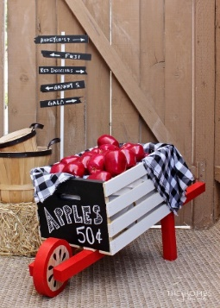
3. Shebang (#!) Scripting
Recent versions of Dyalog APL support Linux-style scripting on all platforms
Linux, Windows, macOS, AIX
Text files starting with "#!/usr/bin/dyalogscript" are fed to the interpreter

Slide 24
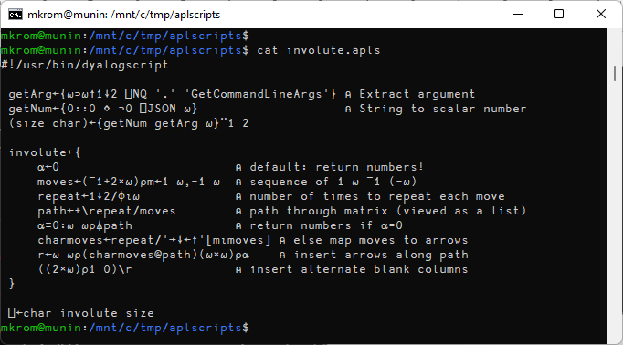
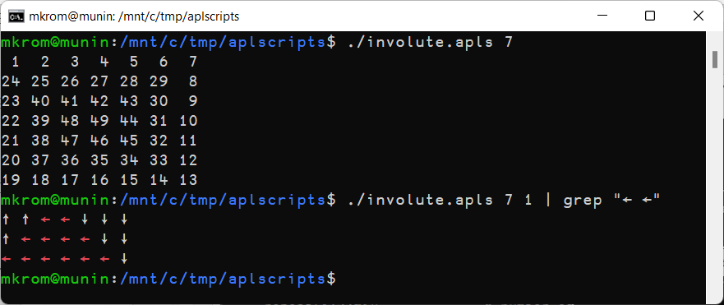

Slide 25
4. Cross-Platform GUI (Desktop or Web)
Since version 2018, Dyalog APL wraps the Chromium Embedded Framework on all platforms except IBM AIX
Windows, macOS, Linux (Intel and ARM)
A library of APL classes to generate HTML/JS is available (and some users roll their own)
The same UI generation tools can be used to create web servers.

Slide 26
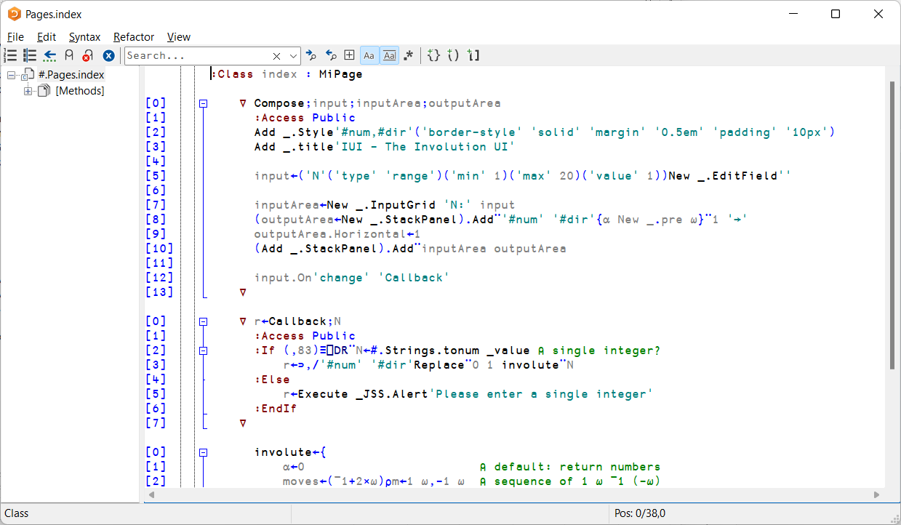
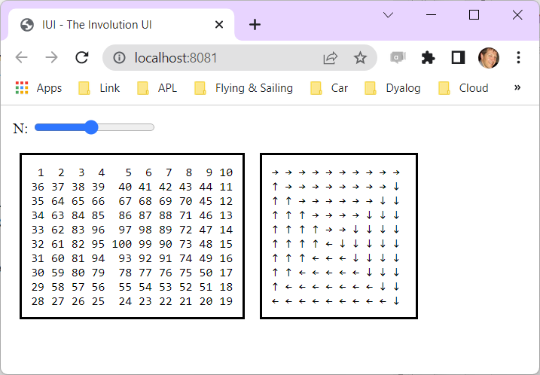

Slide 27
4. Cross-Platform GUI (Desktop or Web)
Since version 2018, Dyalog APL wraps the Chromium Embedded Framework on all platforms except IBM AIX
Windows, macOS, Linux (Intel and ARM)
Note that the Web Server version of the demo also works under AIX – it is only the CEF that is not available

Slide 28
"Integrated" APL
The first four examples used Dyalog APL "out of the box" and no other components
The last three demonstrate different ways to embed APL engines into other tools or frameworks
APL called from Python (using PynAPL underWindow)
Microsoft.NET Assembly (called from C# under Linux)
Web Service in a Docker Container (called in various ways)

Slide 29
5. Called from Python via PynAPL
PynAPL is a bi-directional interface
Call Python from APL or APL from Python
Converts data structures
Allows defining functions across the border
Open source at https://github.com/dyalog/pynapl

Slide 30
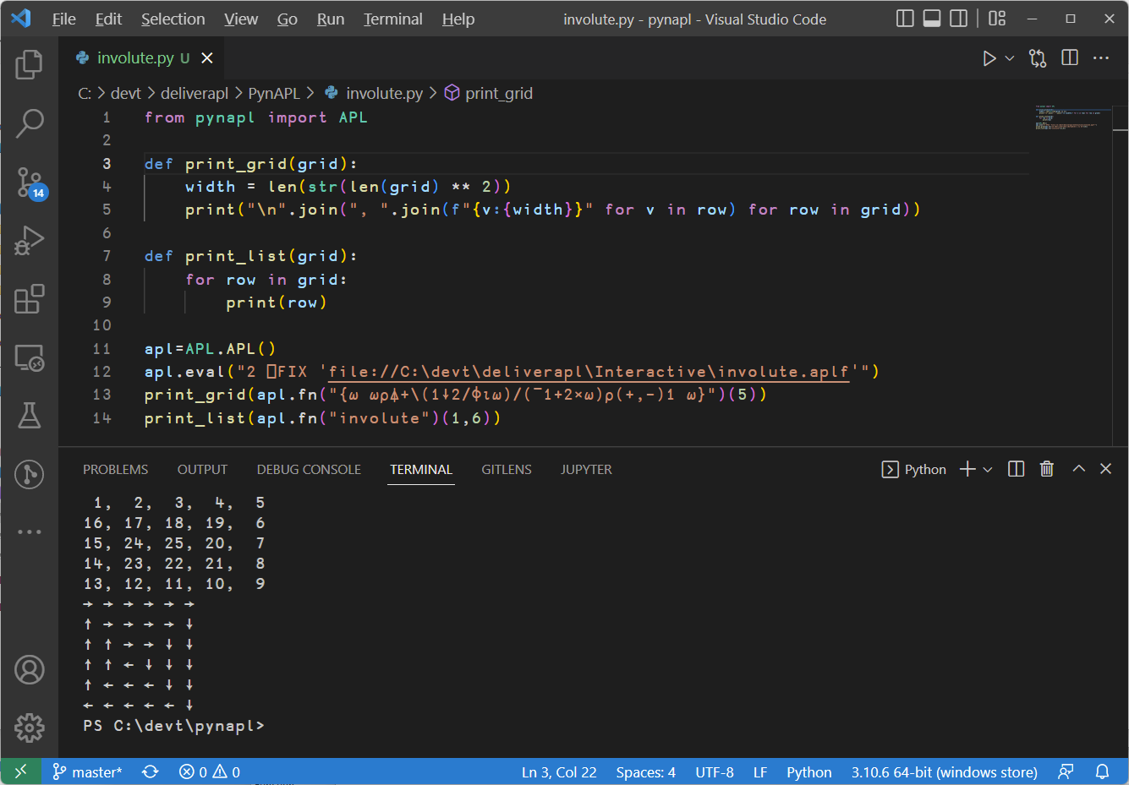

Slide 31
4. Shared Library
We provide a framework which makes it simple to call APL from C
This allows you to you to easily create a shared library and call APL from it
A pre-compiled library called JSON_APL is included on all platforms, it exposes a couple of functions which take string arguments:
Load APL code into the engine
Call APL functions using JSON to represent arguments and results
In our example we will call this from Python...

Slide 32
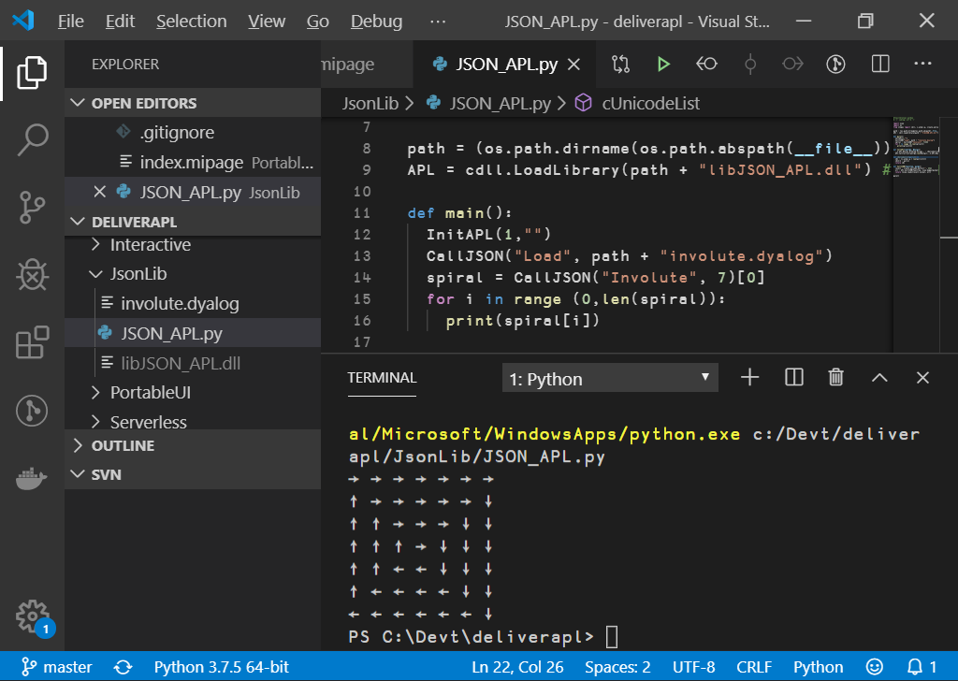

Slide 33
6. Microsoft.NET Assembly
Dyalog APL has supported Object Oriented programming since Microsoft.NET v1.0
Applications can make use of .NET libraries, and also generate .NET assemblies
Including writing APL classes which inherit from C# classes or any other .NET language
We will generate a .NET assembly and call it from C#

Slide 34
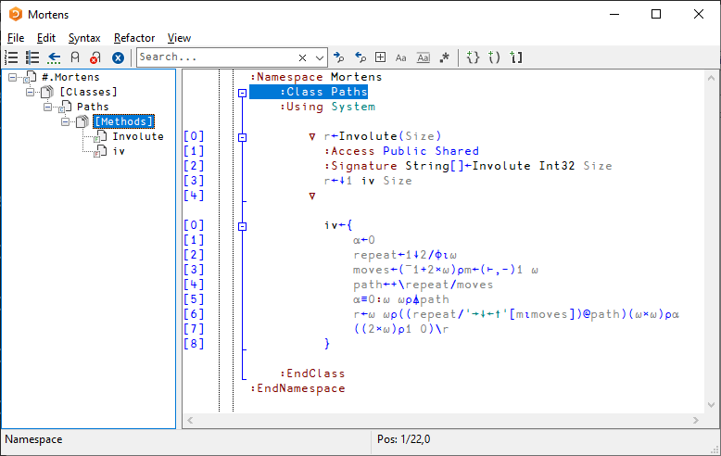

Slide 35
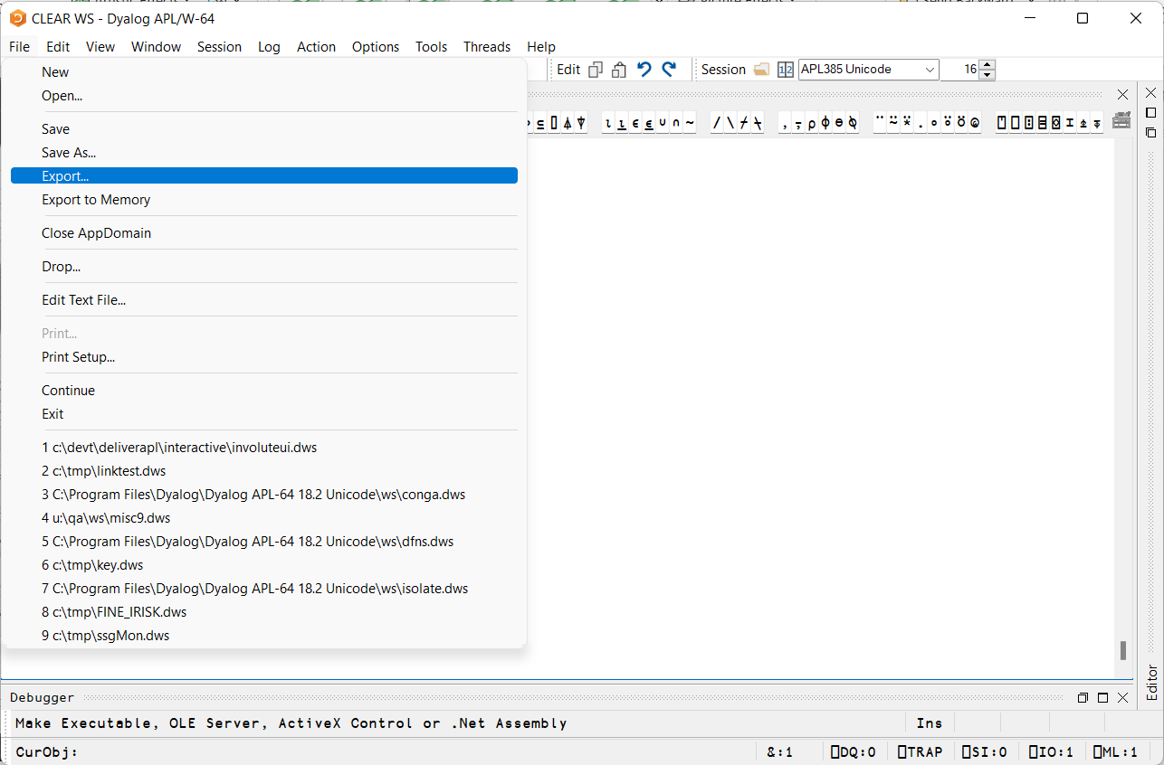
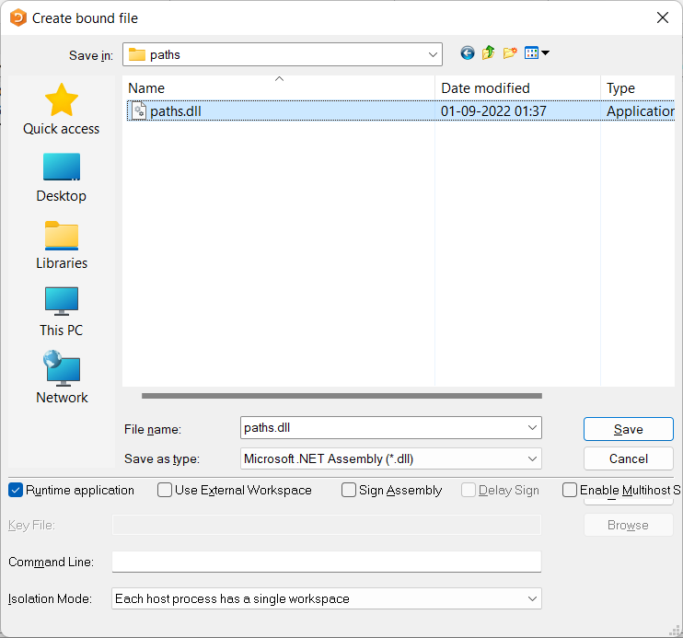

Slide 36
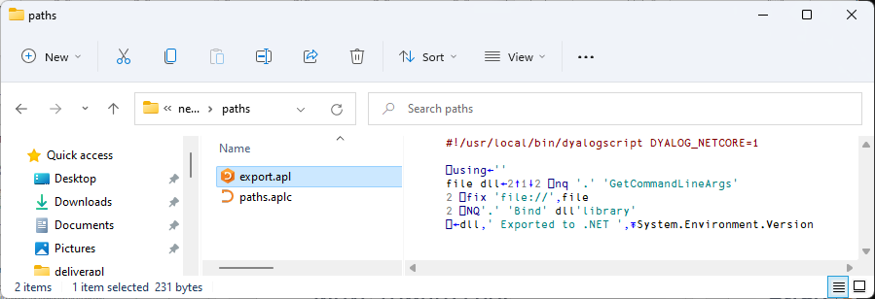
Run: ./export.apl paths.aplc paths.dll

Slide 37
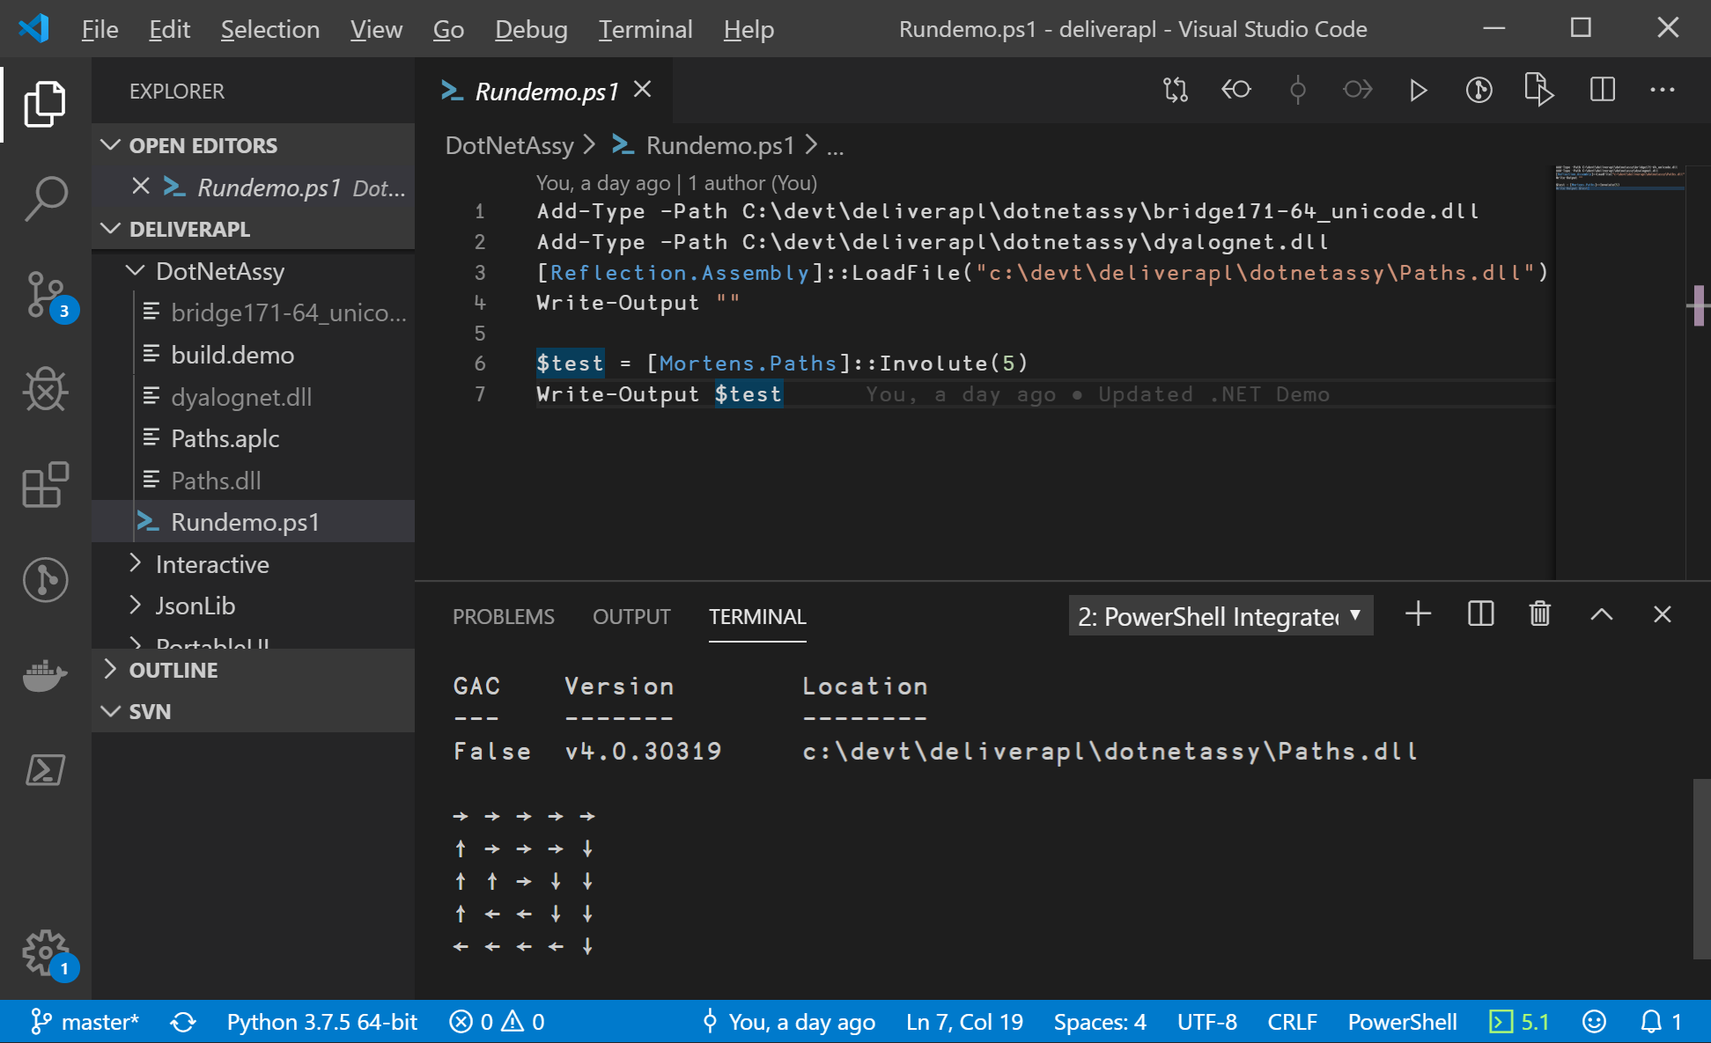
In 2018… Using Powershell

Slide 38
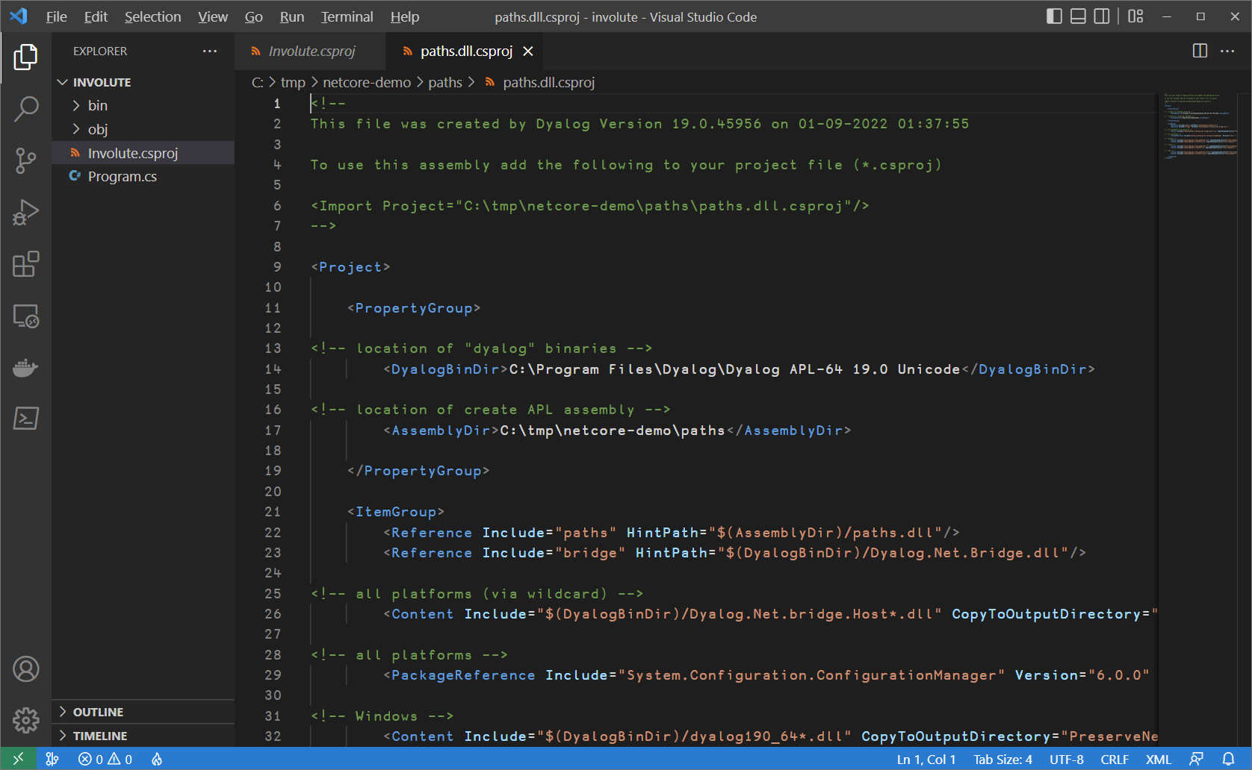
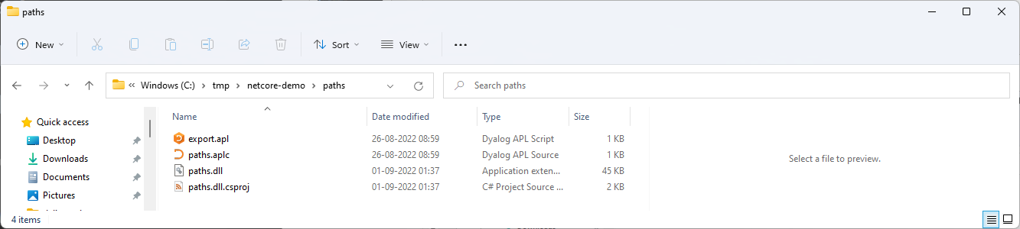
In 2023 (Version 19.0 - .NET 6.0 pka "Core")

Slide 39
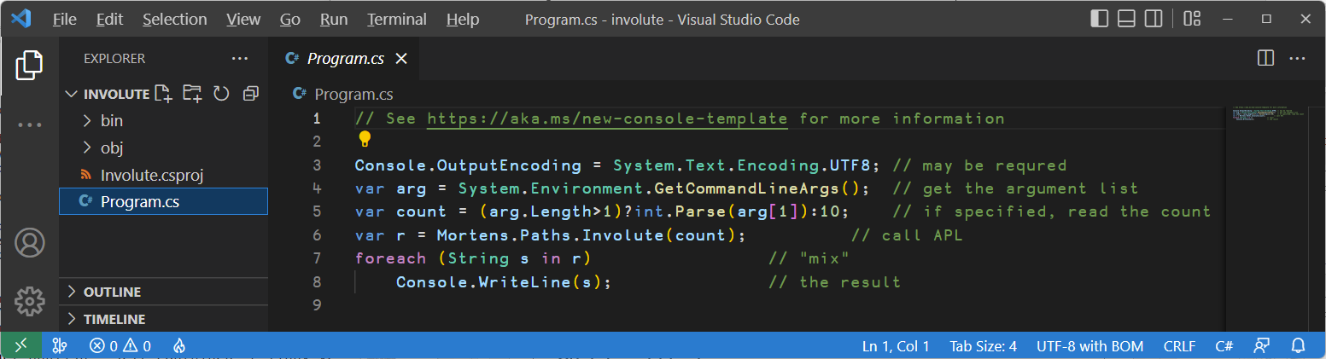
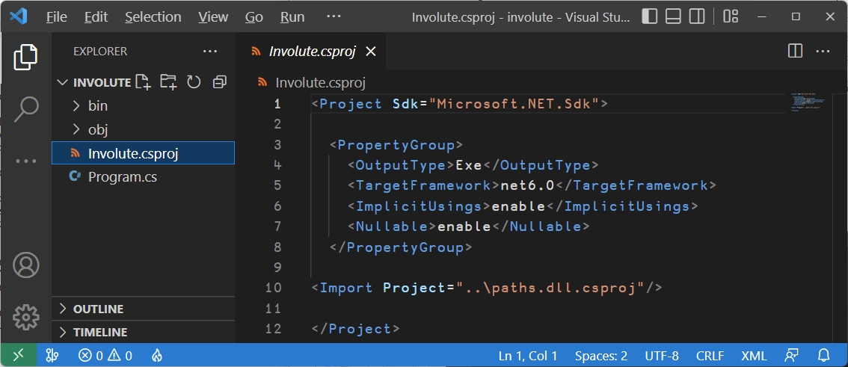

Slide 40
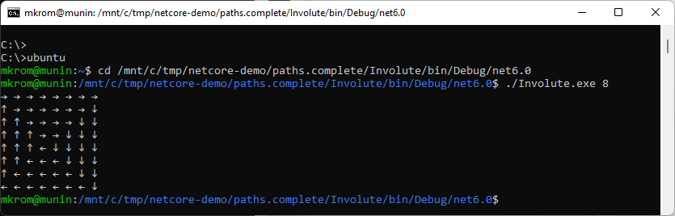

Slide 41
7. Web Service in Docker Container
Dyalog provides a number of pre-built containers on dockerhub
dyalog/dyalog: Dyalog APL only
dyalog/jarvis: REST and HTTP/JSON Web Service framework
dyalog/miserver: Web Server UI framework (deployment #4)
dyalog/jupyter: Jupyter Notebook server
We will use the dyalog/jarvis image to expose a simple web service

Slide 42
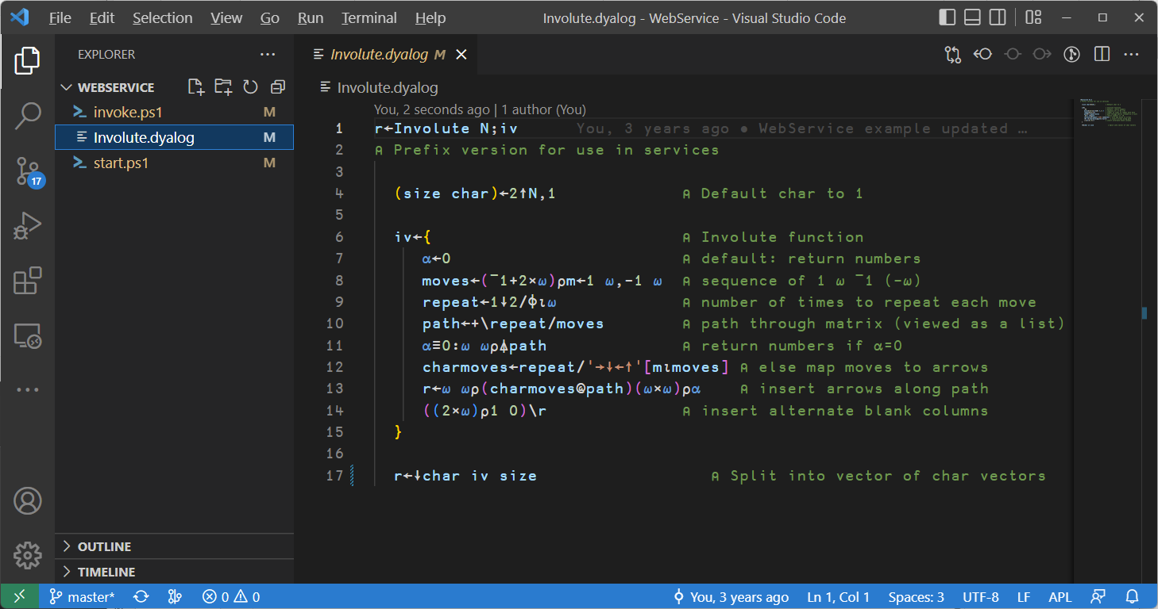

Slide 43
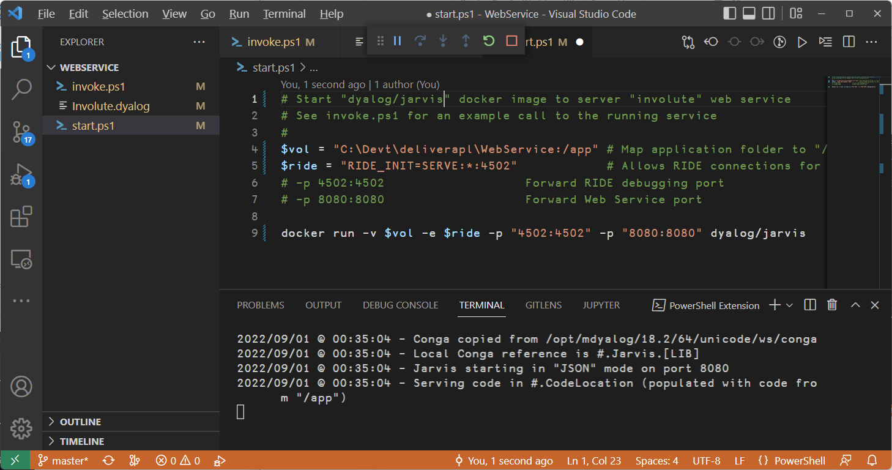

Slide 44
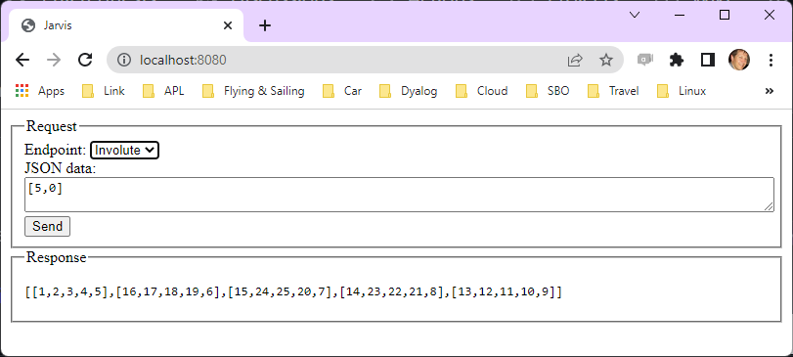
By default, Jarvis exposes a simple UI for testing

Slide 45
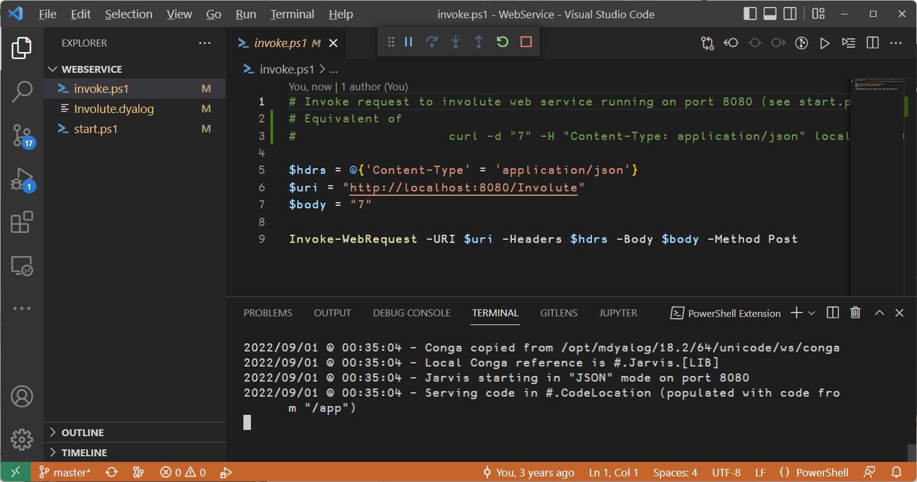
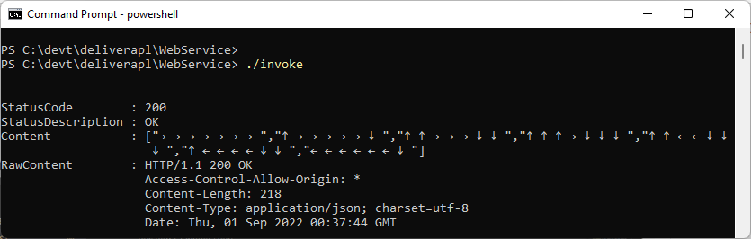

Slide 46
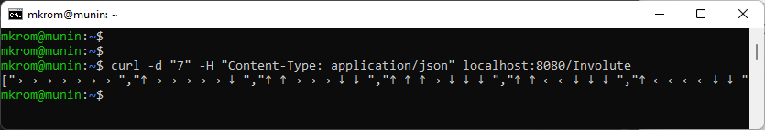
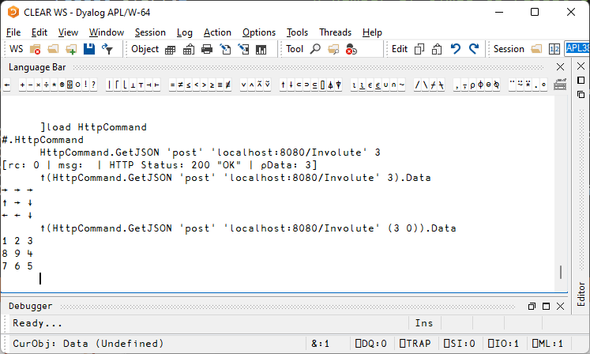

Slide 47
8. Serverless (Amazon Web Sevices Lambda)
APL AWS layer at https://github.com/mvranic/apl-lambda is based on https://github.com/lambci/node-custom-lambda by Marko Vranic from SimCorp A/S.
The rest is easy…

Slide 48
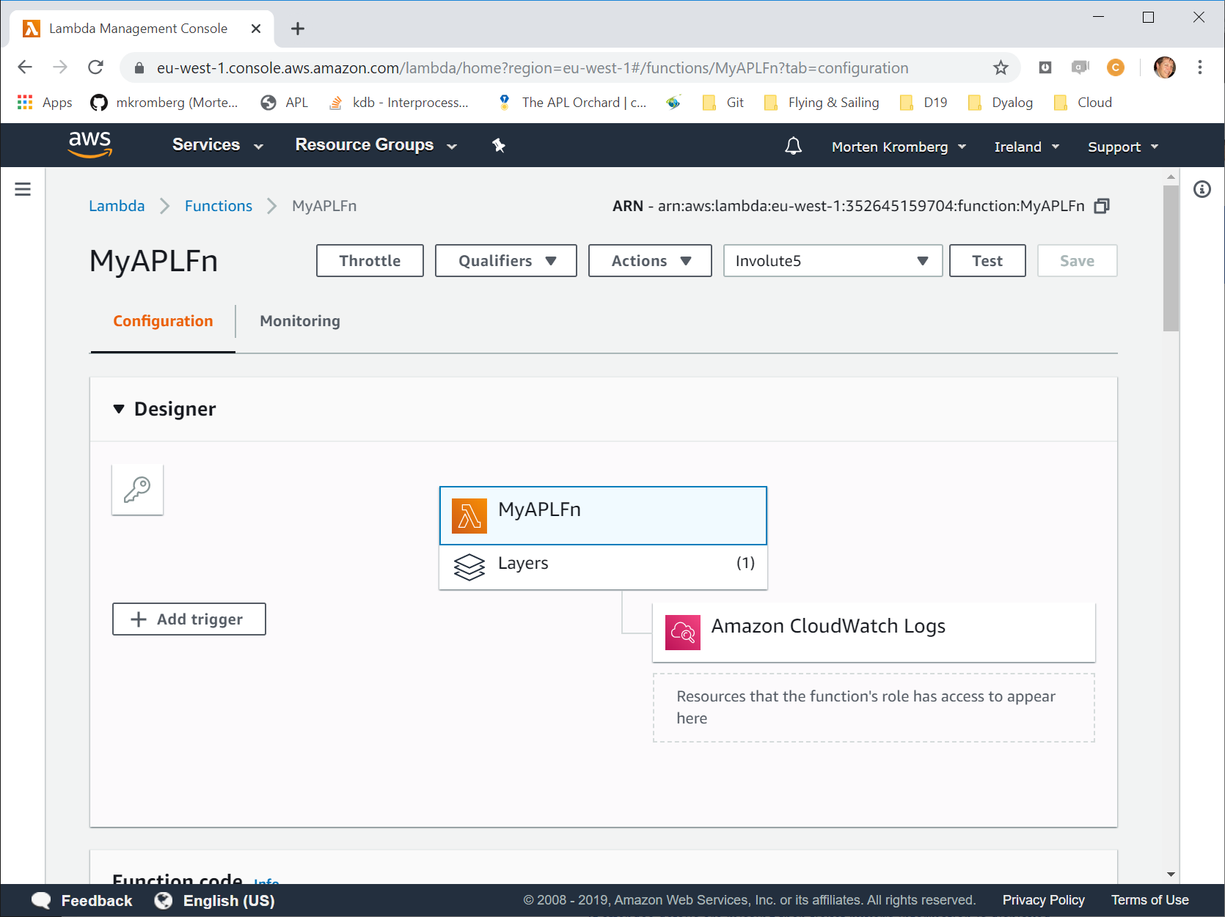

Slide 49
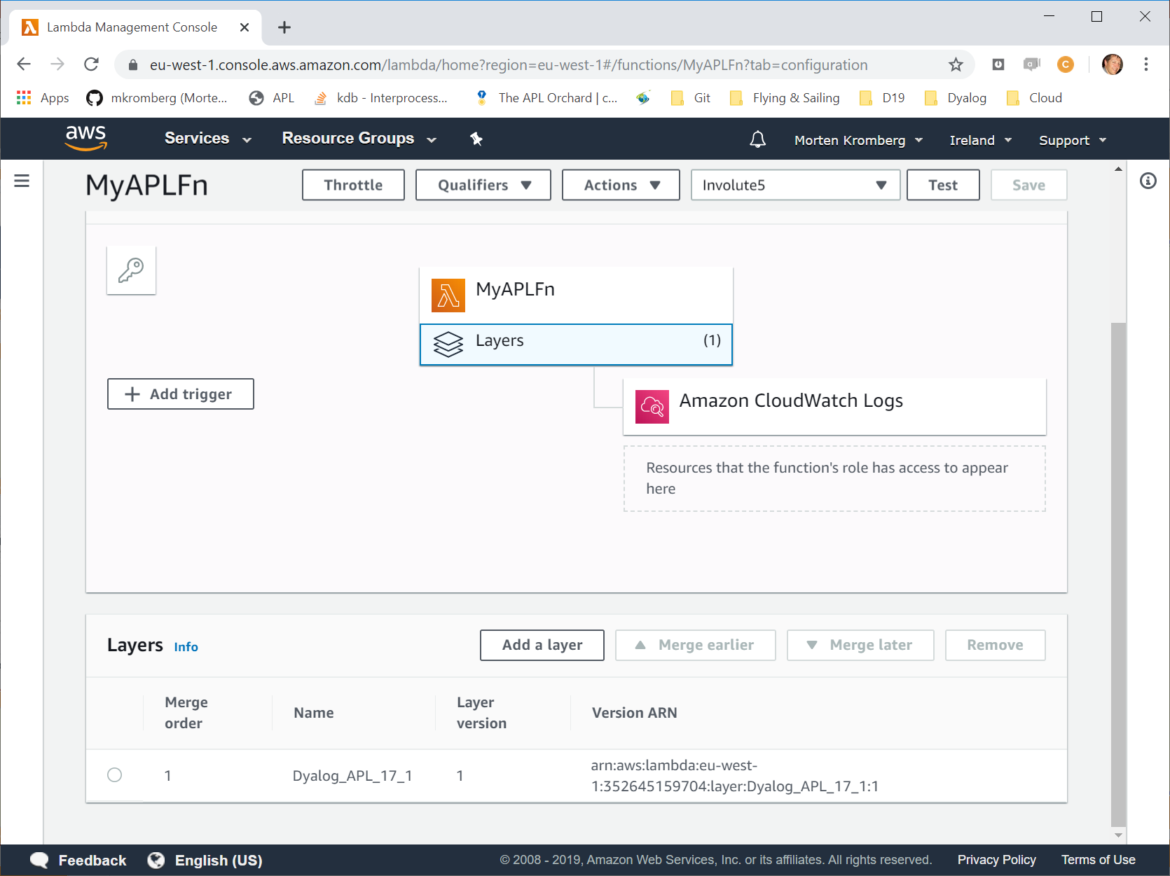

Slide 50
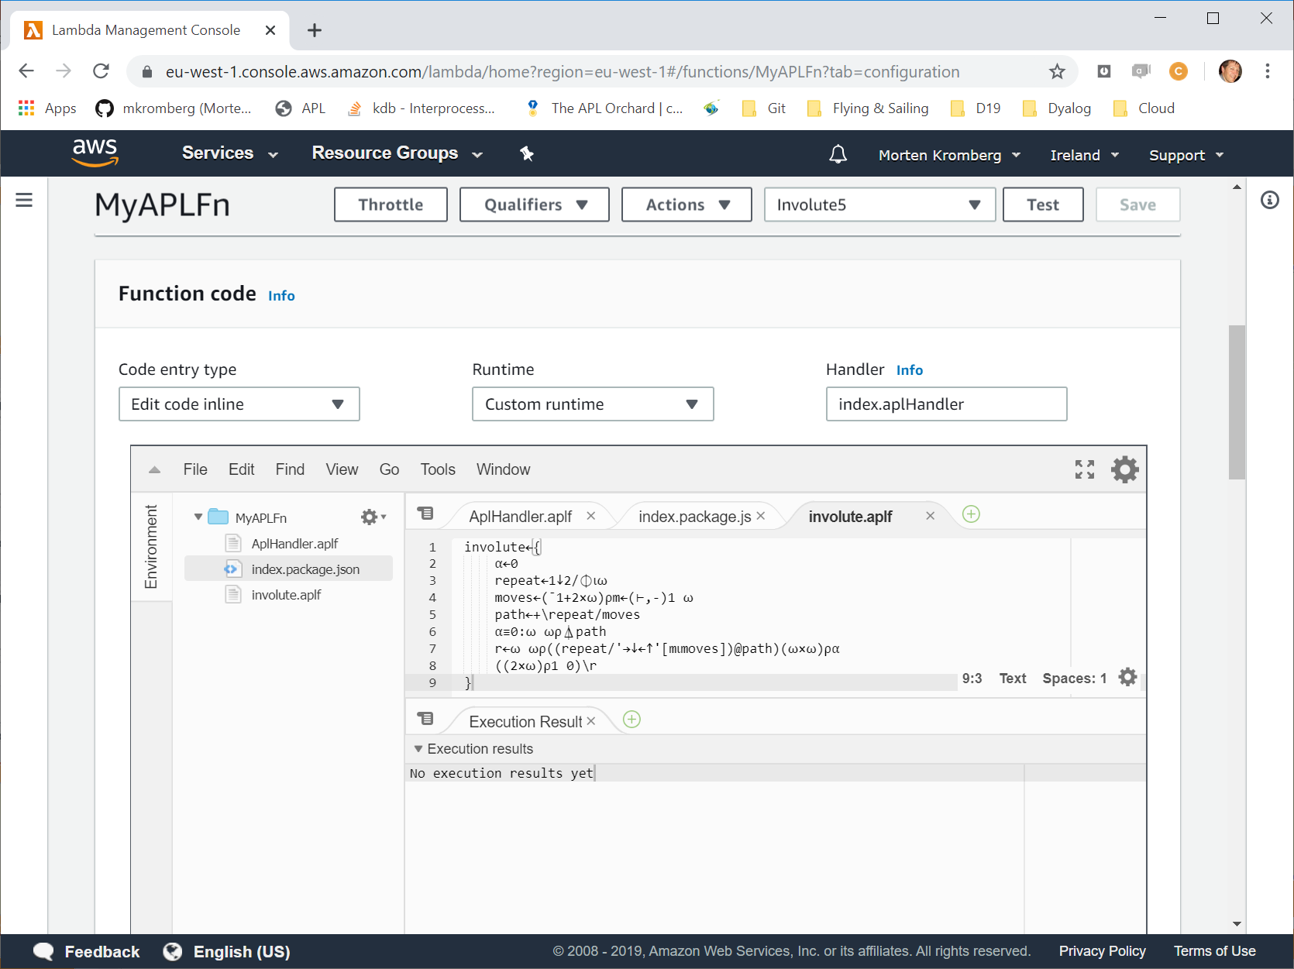

Slide 51
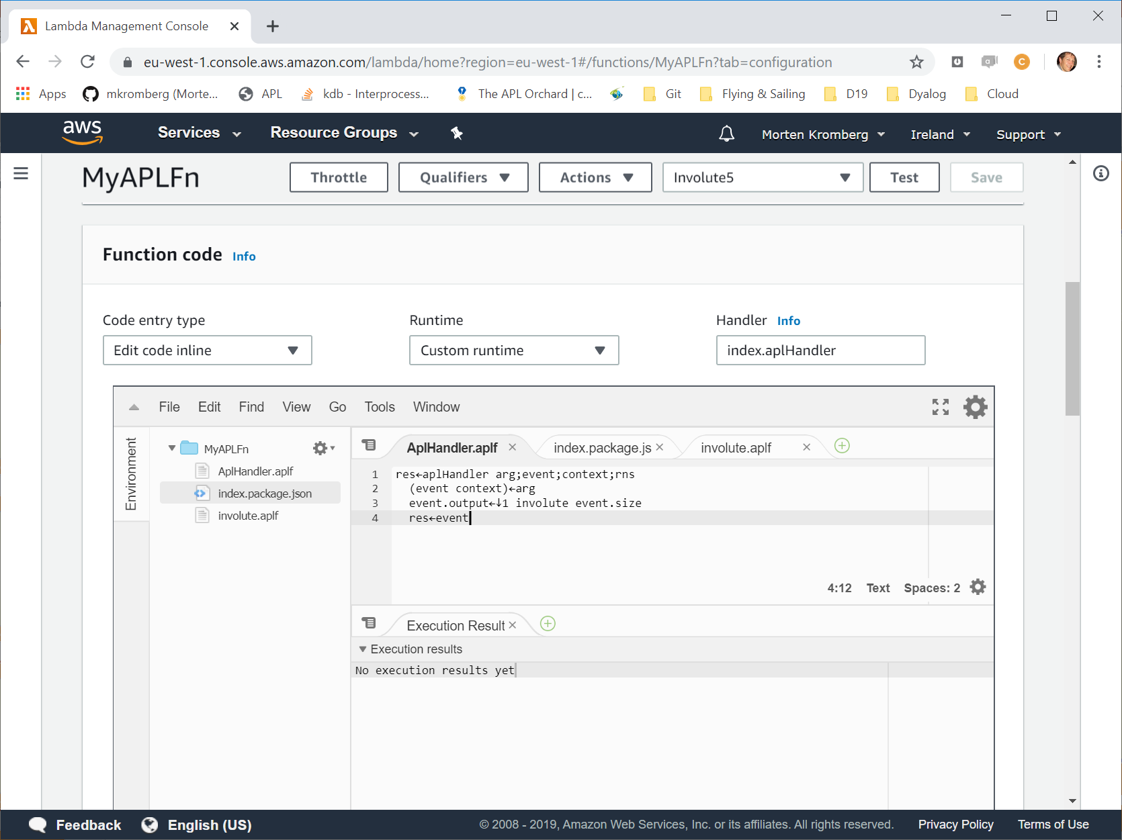

Slide 52
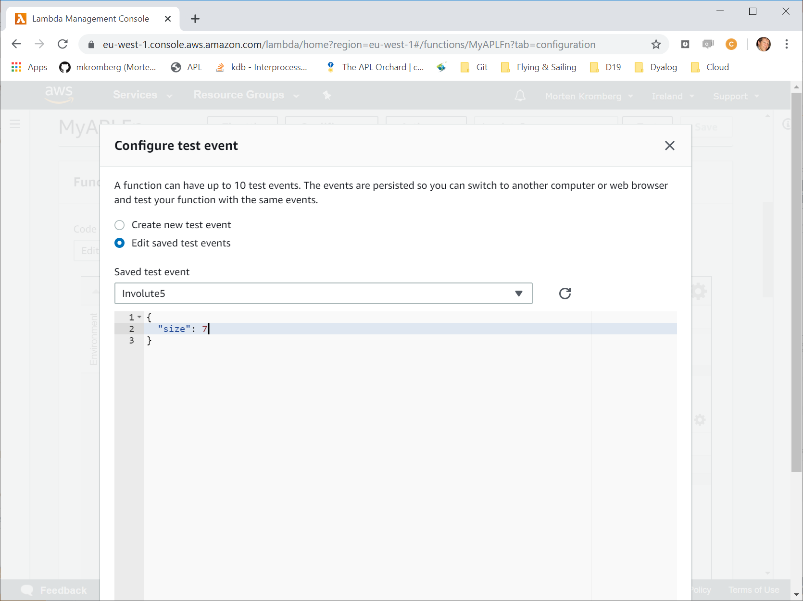

Slide 53
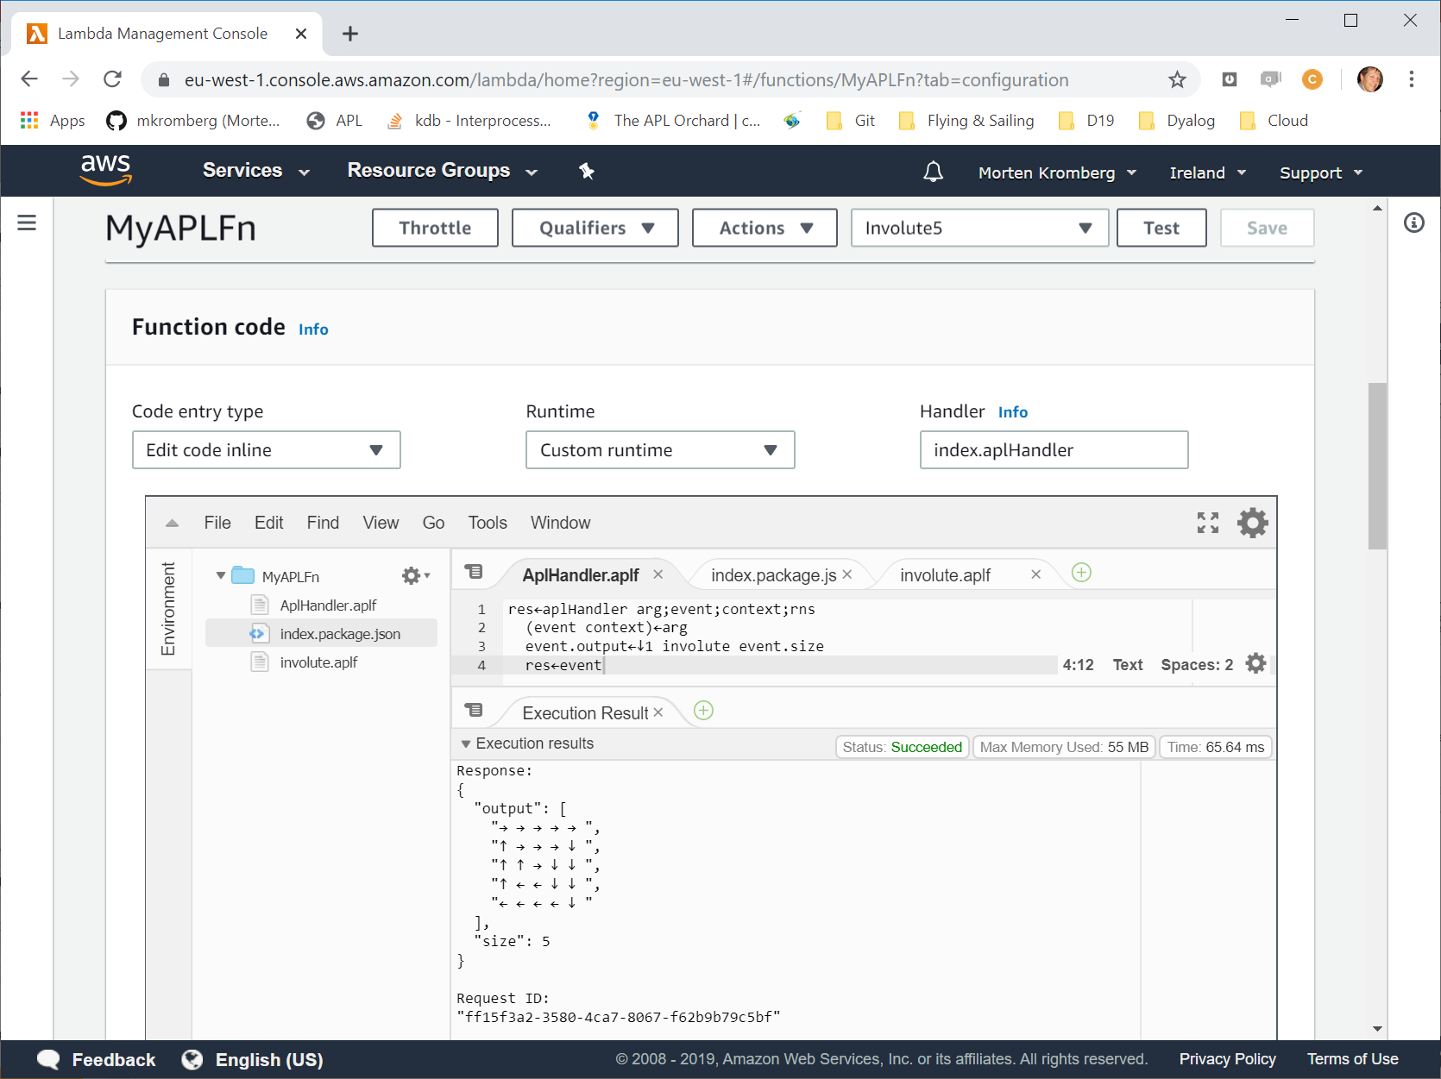

Slide 54
7 Deployments in 7x5 minutes
Full Stack in APL
Interactive APL Session - Windows
Shebang Script - Linux
Windows GUI "Stand Alone Executable"
Cross-Platform GUI (Desktop AND Web)
Integrated APL Components & Services
Integrated with Python (using PynAPL under Windows)
.NET Assembly (called from C# under Linux)
Web Service in Docker Container (Powershell under Windows & curl under Linux)

Slide 55
Some Deployments NOT Demonstrated
COM/OLE Server including ActiveX
Similar to .NET Assembly
Allows old style Excel add-ins implemented in APL
Microsoft.NET integration also allows e.g.
Dyalog APL as an ASP.NET language
SharePoint components & Office add-ins using VSTO
WCF etc etc etc
APL Application as a C DLL
Including pre-packaged solution available using JSON input/output
AWS ServerLess "Lambda"
See example at https://github.com/mvranic/apl-lambda

Slide 56
Key Simplification: Think of Matrix as a Long List
1 2 3 4 5 6 7 8 9 10 11 12 13 14 15 16 17 18 19 20 21 22 23 24 25
Movement: → Add 1 to index
↓ Add 5 to index ← Subtract 5 from index ↑ Subtract 1 from index
(repeat until done)

Slide 57
Key Simplification: Think of Matrix as a Long List
5 5⍴⍳25 1 2 3 4 5 6 7 8 9 10 11 12 13 14 15 16 17 18 19 20 21 22 23 24 25
→ Add 1 to index
↓ Add 5 to index ← Add ¯1 to index ↑ Add ¯5 to index
involute←{ moves←(¯1+2×⍵)⍴(+,-)1 ⍵ ⍝ sequence of 1 ⍵ ¯1 (-⍵) repeat←1↓2/⌽⍳⍵ ⍝ number of times to repeat each move path←+\repeat/moves ⍝ path through matrix (viewed as a list) ⍵ ⍵⍴⍋path ⍝ grade and make matrix }
⍳5 5
┌───┬───┬───┬───┬───┐
│1 1│1 2│1 3│1 4│1 5│
├───┼───┼───┼───┼───┤
│2 1│2 2│2 3│2 4│2 5│
├───┼───┼───┼───┼───┤
│3 1│3 2│3 3│3 4│3 5│
├───┼───┼───┼───┼───┤
│4 1│4 2│4 3│4 4│4 5│
├───┼───┼───┼───┼───┤
│5 1│5 2│5 3│5 4│5 5│
└───┴───┴───┴───┴───┘
→ Add (0 1) to index
↓ Add (1 0) to index ← Add (0 ¯1) to index ↑ Add (¯1 0) to index
involute←{ moves←(¯1+2×⍵)⍴(+,-)(0 1)(1 0) ⍝ seq of (0 1)(1 0)(0 ¯1)(¯1 0) repeat←1↓2/⌽⍳⍵ ⍝ number of times to repeat each move path←+\repeat/moves ⍝ path through matrix (viewed as a list) ⍵ ⍵⍴⍋path ⍝ grade and make matrix }

